Slide 1

Download Form 16
Financial Year 2023-24

Slide 2
Download Form 16 from HGS Portal
Steps to Download and Extract Form 16
Log into HGS Portal
Go to Reports Section => Select Tab, Form 16
Select the Financial Year and download the Form 16 file on your desktop/personal folder
Extract the Form 16 using 7-Zip / 7-Zip File Manager
Password to open the Form 16 PDF file is your Permanent Account Number (PAN) in Capital Letters
Important Note :
Form 16 is an Important document. Kindly save/print the document and keep it safely in your personnel folder/file.
Refer Slide # 4 for Unzipping the Form 16

Slide 3
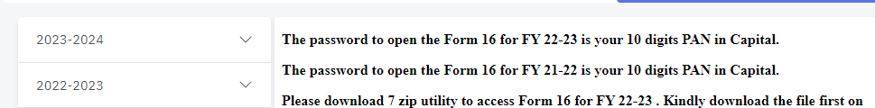
Download Form 16 from HGS Portal
Login to HGS Portal, Reports Section and Click on FY 2023 – 2024 to download Form 16
Form 16 downloaded is in Zip Format which needs to be extracted.

Slide 4
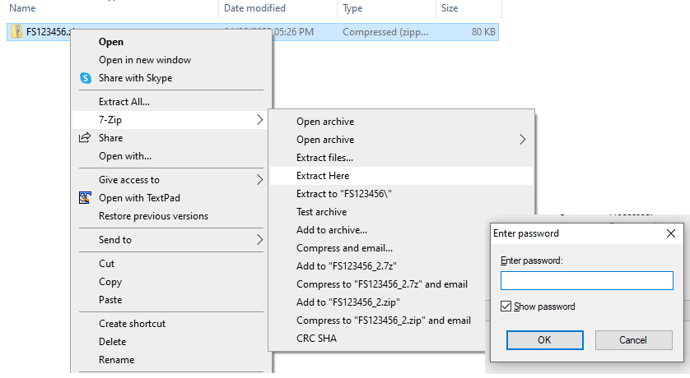
Steps to Extract Form 16
Follow the below steps to extract the Form 16
Right click on the zip file and choose the 7-zip > Extract to “Folder Name”
Password to Open the Form 16 is your Permanent Account Number (PAN) in capital letters

Slide 5
Download Form 16 – Validating Signature
Steps followed for Validating Signature in Form 16
To validate the Digital Signature on your version of Adobe reader you need to follow the following steps after opening the pdf File
Upon opening the Form 16 PDF document, the Digital Signature will appear on your Form 16.
Right Click on the box showing the digital signature.
Select Show Signature properties
Select Show Certificate
Select Trust
Click Add to Trusted Identities
Click OK
Click Select all the checkboxes of New window
Click OK
Click Verify/Validate Signature
You can also click on the "Signature Panel" on the first page of the attachment and then click "Validate All" to get the signature validity.
Validation of Signature in Form 16 could take few minutes

